Slide 1
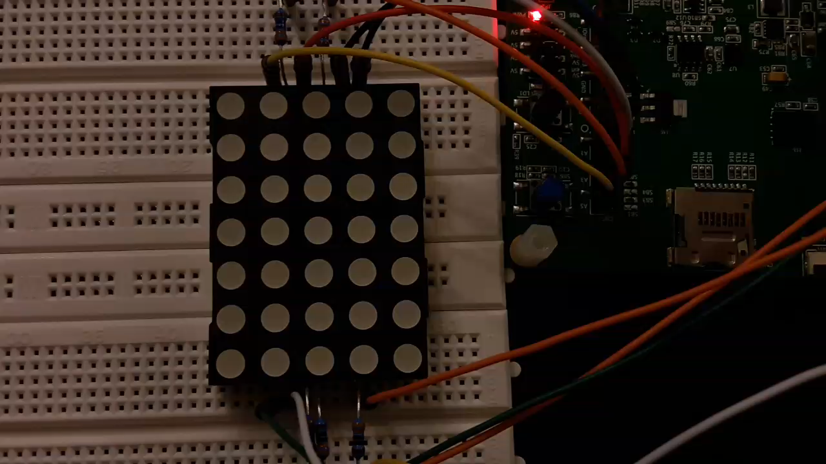
Demo – week 9
András Pásztor
08.12.2017

Slide 2
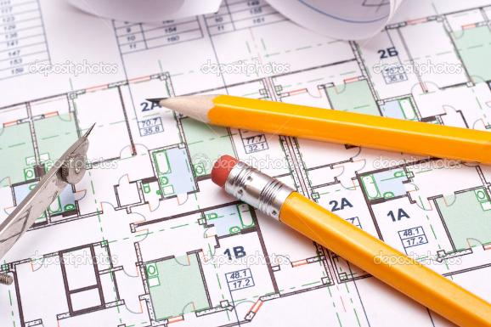
Past
Architectural Engineer

Slide 3
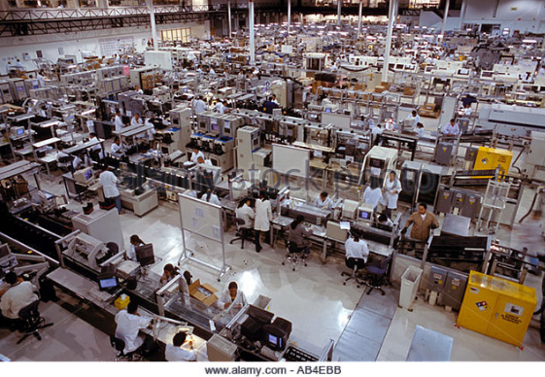
Past
Facility Engineer
Electronic assembling plant

Slide 4



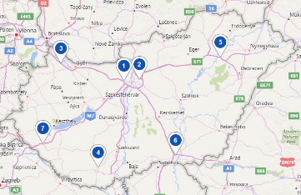
Past
Facility and Property Manager

Slide 5
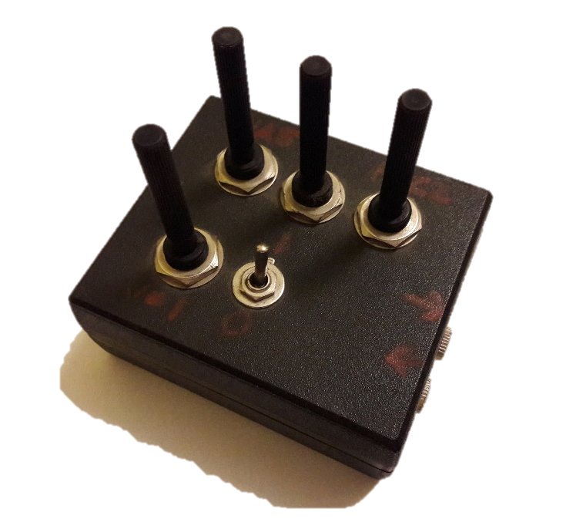
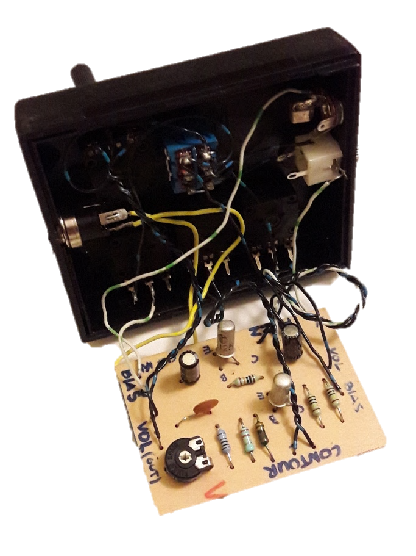
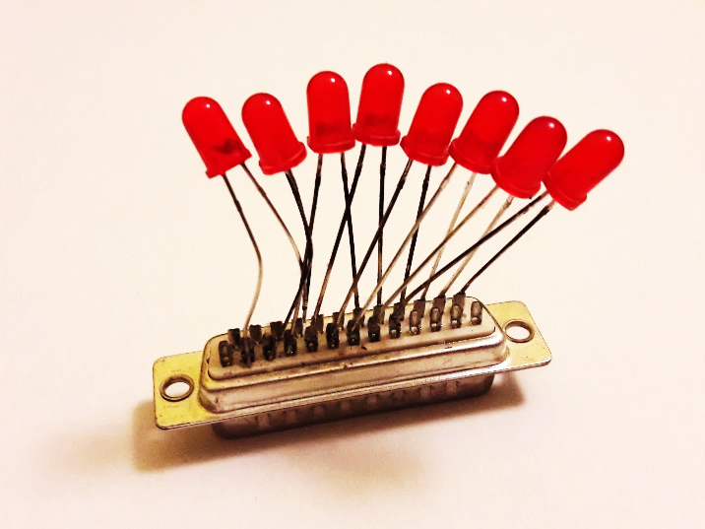
Long time ago…
Programing and Electronics

Slide 6
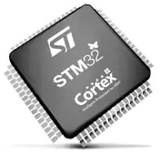
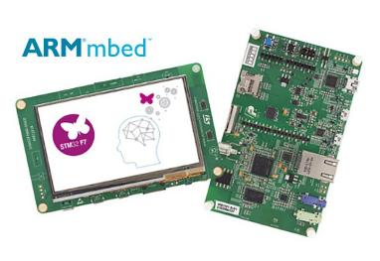
Timing
STM32F7

Slide 7
Timing
The problem was…
How to calculate the setup of a TIMx timer to have
1 Hz pulse?

Slide 8
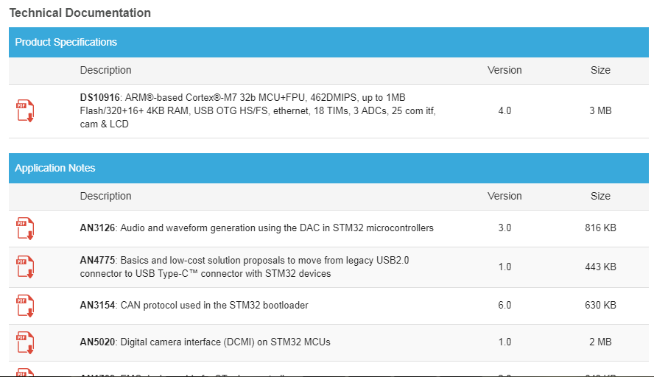
Timing
STM32F7
Discover the documentation of MCU

Slide 9
Timing
STM32F7
Discover the documentation of MCU
Datasheet
Reference Manual
General-purpuse Timer Cookbook

Slide 10
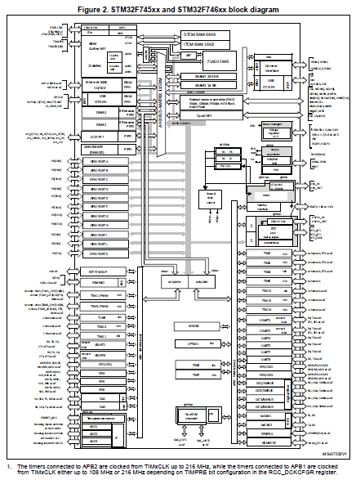
Timing
Datasheet
MCU Block Diagram

Slide 11
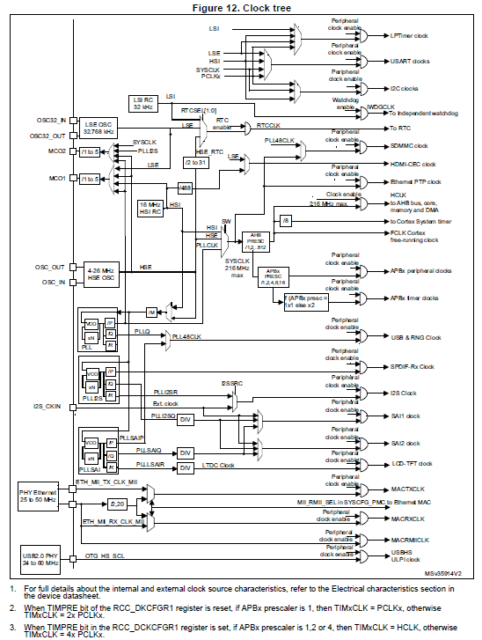
Timing
Reference Manual
Clock Tree

Slide 12
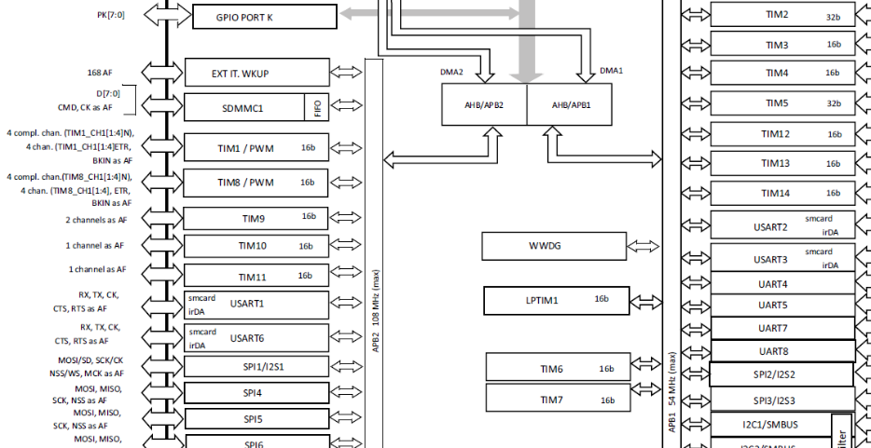
Timing
Block Diagram

Slide 13
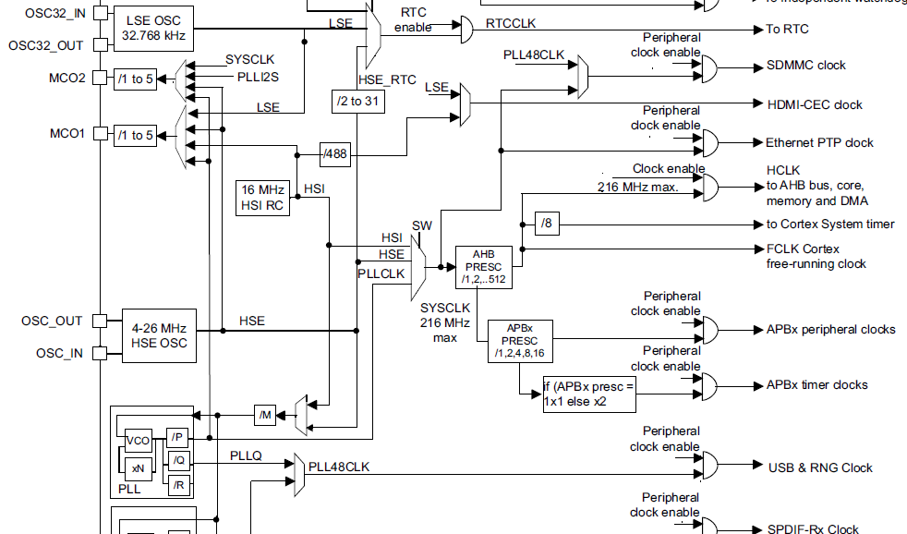
Timing
Clock Tree

Slide 14
Timing
Calculate
How to calculate the setup of the TIM1 timer to have 1 Hz pulse?
PLL is set to 216 MHz
TIM1 is on APB2

Slide 15
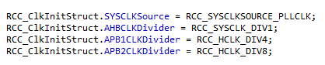
Timing
Calculate
PLL 216 MHz
AHB_PRESC 1
APB2_PRESC 8
If (APBx_PRESC = 1)
then x1
else x2
TIM base clock = PLL / AHB_PRESC / APB2_PRESC x 2
TIM base clock = 216 Mhz / 1 / 8 x 2 = 54 MHz

Slide 16
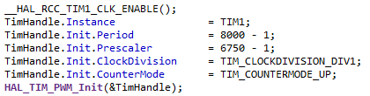
Timing
Calculate
TIM base clock = 216 Mhz / 1 / 8 x 2 = 54 MHz
TIM base clock 54 000 000 Hz
TIM prescaler 6750
TIM period 8000
TIM clock = 54 000 000 Hz / 6750 / 8000 = 1 Hz

Slide 17

Take Home Message
Take time to find and check the manuals

Slide 18
Thank you for your attention
András Pásztor

